Slide 1
JIT121 Programming Principles
Lecture 7
Exceptions, Inheritance, Polymorphism
Notes:
Terminology pref: Base and Subclass (aot parent, superclass and child).

Slide 2
Goals of Lesson
Exceptions
Inheritance
Polymorphism

Slide 3
Exceptions
An exception is an "unexpected" event during execution
  Program continuation is either impossible or undesirable
Some common examples are:
  division by zero error (System.DivideByZeroException)
  accessing an array index not in the array (System.IndexOutOfRangeException)
  trying to do something with an un-instantiated object (System.NullReferenceException)

Slide 4
Exception Handling
What to do when an exception occurs?
Two options:
  Do nothing
    Let run-time report the exception and halt
  Handle the exception by implementing an exception handler (writing some code)
    where it occurs; or
    at some other point in the program

Slide 5
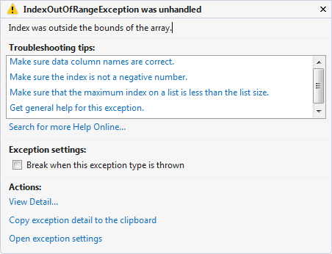
Exceptions : Do nothing approach

Slide 6
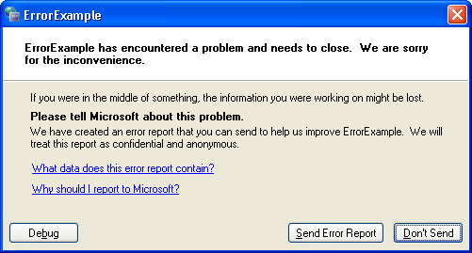
Exceptions : Do nothing approach
Figure 11-9 Microsoft error reporting

Slide 7
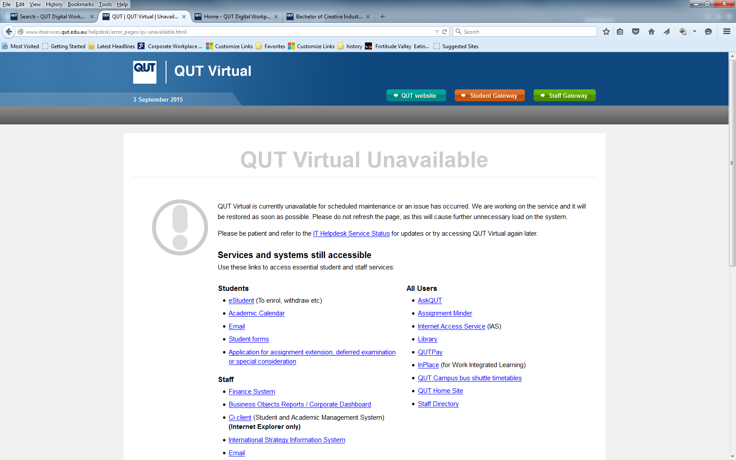

Slide 8
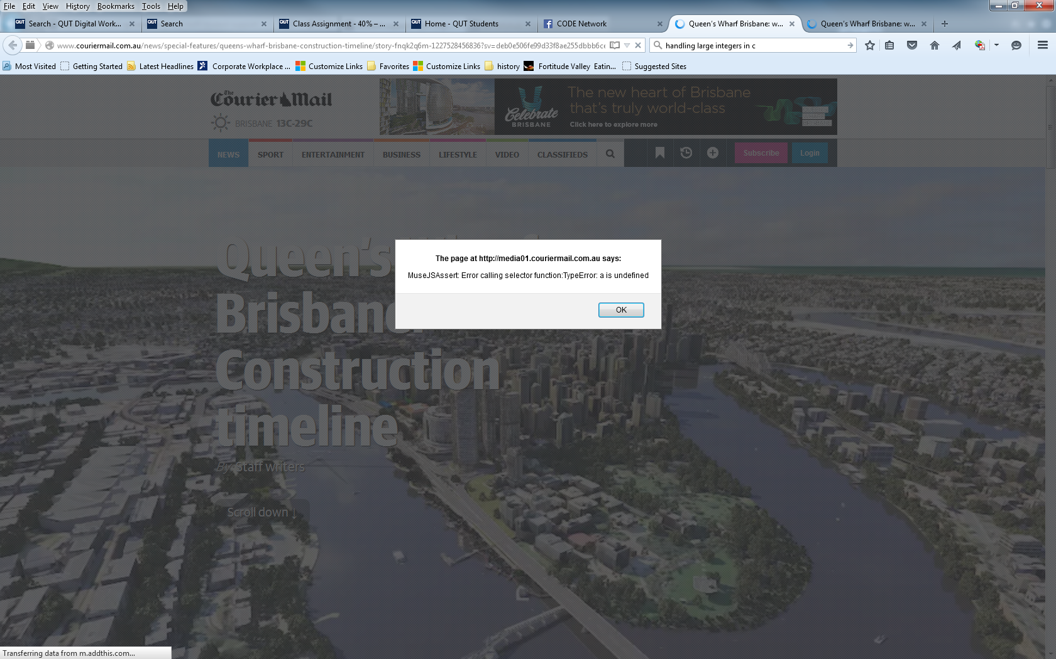

Slide 9
Handling Exceptions
To handle exceptions, use the keywords try and catch (try and except in Python)
Enclose the code which might generate an exception in a try block, and follow by one or more catch blocks
When an exception occurs inside a try block, control immediately passes to the catch block which handles that type (class) of exception
We say that the statement in the try block throws the exception

Slide 10
Handling Exceptions
A catch block should contain code to deal with the exception (exception handler). What the code should do depends on the error
The code in a catch block may or may not be executed
  It is executed only if that type of exception occurs during execution of the try block

Slide 11
Handling Exceptions
The catch block can throw the exception back through the "call chain" to the code which called it
Can have one or more catch per try block
Must have at least one catch block
Can have an optional finally block

Slide 12
try-catch Example
try {
// enclose the code that may throw
// an exception in the try block
int number = 5, zero = 0;
// will throw a DivideByZeroException
int divZero = number / zero;
} catch (DivideByZeroException divExcept) {
// code to execute when an exception occurs
Console.WriteLine("You are trying to "
+ "divide by zero!\n");
}
}

Slide 13
try-catch Block Syntax
Can use a multi-way catch to catch different types of exceptions
try {
… // code which might cause exception/s
…
} catch (exceptionType1 e1) {
… // code to handle this type of exception
} catch (exceptionType2 e2) {
… // code to handle another type of exception
}
… // program continues here

Slide 14
Ordering of Exception Handlers
With multi-way catch blocks, the ordering is important
When an exception occurs the catch blocks are searched in the order of declaration to find the block which handles the exception type
All exceptions are subclasses of System.Exception
... } catch (Exception e) {
… // this will catch ALL exceptions
So if you use the base type Exception in the first catch block of a multi-way catch, other blocks will never be reached

Slide 15
Ordering of Exception Handlers
try {
… // code could cause exception
} catch (Exception e) {
… // this code will execute when ANY
// exception occurs
} catch (NullReferenceException nullEx) {
… // this code will NEVER be reached
// this catch should be before the previous catch
}
Exception object contains information, including a text description of the exception. Can access via:
nullEx.ToString();

Slide 16
Exception Handling Syntax
If you do not use the exception object inside a catch block, then you do not need to name the exception object, just use the type as the parameter:
      try {
      … // code which could cause exception
      } catch (NullReferenceException) {
      // never uses exception object
      Console.WriteLine("Null Ref exception found");
      } catch (Exception except) {
      // code uses exception object
      Console.WriteLine("Got an exception");
      Console.WriteLine(except.ToString());
      throw(except);
      }
Passing exception object back to calling code

Slide 17
Throwing Exceptions
Can throw an exception anywhere – need not be in a catch block
/// <summary>
/// Parameterless constructor.
/// Do not want the generic default constructor to be used
/// and do not want un-named Employees.
/// Overwrites the compiler's generic default constructor.
/// Pre: none
/// Post: ALWAYS throws an ArgumentException.
/// </summary>
/// <remarks>NOT TO BE USED!</remarks>
public Employee() {
throw new ArgumentException("Default constructor invalid.");
} // end constructor

Slide 18
Optional finally Block
finally block is different to a catch block
  The code in a catch block may or may not be executed
  It is executed only if an exception occurs during execution of the try block
A finally block contains code that is ALWAYS executed (even if exception thrown in catch block)
  The finally code is executed when the try block or catch block finishes executing

Slide 19
Example of finally block
private static void TryCatchFinally() {
try {
Console.WriteLine("Executing try code\n");
string str = null;
// will throw a NullReferenceException
int indexOfA = str.IndexOf("a");
} catch (NullReferenceException nullEx) {
Console.WriteLine("Executing catch code\n");
Console.WriteLine(nullEx.ToString() + "\n");
Console.WriteLine("Re-throwing the exception\n");
throw nullEx;
} finally {
Console.WriteLine("\nExecuting finally code\n");
}
}

Slide 20
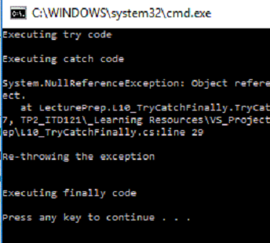
Output…
private static void TryCatchFinally() {
try {
Console.WriteLine("Executing try code\n");
string str = null;
// will throw a NullReferenceException
int indexOfA = str.IndexOf("a");
} catch (NullReferenceException nullEx) {
Console.WriteLine("Executing catch code\n");
Console.WriteLine(nullEx.ToString() + "\n");
Console.WriteLine("Re-throwing the exception\n");
throw nullEx;
} finally {
Console.WriteLine("\nExecuting finally code\n");
}
}

Slide 21
What Happens When Exceptions Occur
When an exception occurs:
  The current block is checked to see if there is an exception handler for that type of exception
If there is not the correct handler for the current block, then the enclosing or calling block is checked
  This continues right back to the entry point of the program (Main method)
If there is no handler, then the exception is reported by the run-time system and the program halts

Slide 22
Activity: Exception Handling
Implement the TryCatchFinally() method (slide 19) in VS and make a call to that method from Main
Run the program and see the outcome
Now handle the returned exception in Main so that the program doesn't crash

Slide 23
Final Word
Over 100 exception types in the .NET framework
Only use exception handling for serious errors that occur infrequently, such as File IO
Errors such as incorrect input format should be dealt with using conditional statements within a loop and instructions to the user to correct the input

Slide 24
Object Oriented Programming
All OOP languages share three characteristics:
Encapsulation
  Data hiding
Inheritance
  Share some characteristics with parent class
Polymorphism
  Ability of different objects to interpret and respond to program commands, or messages, in a way that makes sense to that particular object

Slide 25
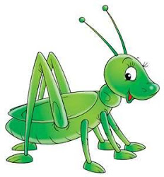
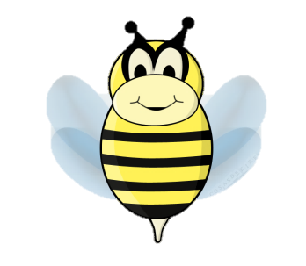
Inheritance
In our world, many objects are specialised versions of a more general object
Consider "insects". They are a general type of creature with certain characteristics:
  2 pairs of wings
  3 pairs of legs
  body with 3 distinct segments
  antennae

Slide 26
Inheritance
Grasshoppers and bees are both insects
  share general characteristics
  each has own special characteristic
  A grasshopper is an insect, a bee is an insect
  An insect is not a …
  Inheritance:
  is a one-way relationship
  is called an "is-a" relationship

Slide 27
Inheritance
Inheritance allows us to define a general class containing the common attributes and behaviours, then create sub-classes extending it
  Sub-classes inherit all members of the parent class and can also add more members of their own
Note that C# and Java have only single inheritance and not multiple inheritance

Slide 28
What is Inheritance?
If one class B extends an existing class A, then:
  B inherits all the instance variables of A
    (but has access only to those public or protected)
  B inherits all the public and protected methods of A
  B can add new instance variables and methods specific to B
  B can "override" a method of A to provide different behaviour
Possible to extend any class unless it is a sealed class
public sealed class Pen {

Slide 29
Inheritance
Syntax: …SubclassName : ParentClassName {
  Example: public class B : A { // B extends A
The class which is being extended is called:
  base class OR superclass OR parent
The class which extends another class is called:
  subclass OR child
So for a class B which extends a class A
  A is the base class
  B is the subclass

Slide 30
Inheritance - example
using System.Windows.Forms;
public class Form1 : Form {
...
subclass
Base class

Slide 31
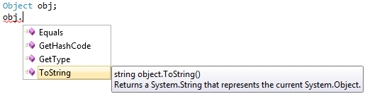
Inheriting from the Object Class
Every C# object inherits four methods.
Methods inherited from the Object class
All classes in C# are subclasses of the Object class

Slide 32
Inheritance – recall Coin class
// Returns the current face of the coin
// as a string
public override string ToString() {
return face.ToString();
} //end ToString
override – allows subclass to redefine a method inherited from its base class (or grandparent or …)

Slide 33
Inheritance - example
Circles, squares and triangles are all general 2D shapes (polygons)
This can be represented by an "is-a" relationship between subclass and base class
Each of the shapes have attributes in common
  area, perimeter
The calculation of each attribute is different for each shape

Slide 34
Inheritance – example by UML
TwoD_Shape
-area: double
+TwoD_Shape() +GetArea(): double
is-a
is-a
is-a
Circle
-radius: double
+Circle() +Circle(double) +GetArea(): double
Triangle
-base: double -height: double
+Triangle() +Triangle(d…,d…) +GetArea(): double
Square
-side: double
+Square() +Square(double) +GetArea(): double

Slide 35
Inheritance – example Base Class
public abstract class TwoD_Shape {
private double area;
public TwoD_Shape() {
}
public virtual double GetArea() {
return double.MinValue;
}
// possibly other methods here
}
Method may be overridden in subclass

Slide 36
Inheritance – example Subclass
public class Circle : TwoD_Shape {
private double radius = -1;
public Circle() {
throw new NotImplementedException();
}
public Circle(double radius) {
if (radius > 0)
this.radius = radius;
}
public override double GetArea() {
return 2 * Math.PI * radius;
}
}
Overriding the method in the base class

Slide 37
Inheritance – example Subclass
public class Triangle : TwoD_Shape {
private double tBase = -1, height = 1;
public Triangle() {
throw new NotImplementedException();
}
public Triangle(double tBase, double height) {
if ((tBase > 0) && (height > 0)) {
this.tBase = tBase;
this.height = height;
}
}
public override double GetArea() {
return tBase * height / 2;
}
}
Overriding the method in the base class

Slide 38
virtual and abstract methods
virtual methods may (but need not) be overridden in the subclass
abstract methods must be implemented in the subclass (using keyword override
Any class containing an abstract method must be declared as an abstract class
An abstract class:
cannot be instantiated (cannot create an object from it)
does not have to contain abstract methods

Slide 39
Jargon check…
Overloading deals with multiple methods in the same class with the same name but different signatures | Overriding deals with two methods, one in a base class and one in a subclass, that have the same signature
Overloading lets you define a similar operation in different ways for different data | Overriding lets you define a similar operation in different ways for different object types

Slide 40
Inheritance Example - Employee
Employees have common characteristics
  name, employee number, pay rate
However some employees are full-time and some are part-time
Pays for full-time employees are calculated in a different way to part-time employees

Slide 41
Inheritance Example - Employee
The Employee Class will have attributes and behaviours that are common to all employees
Two subclasses of Employee which have attributes and behaviours specific to that type of employee
  Part-time employed for number of hours
  Full-time have an annual salary
    So calculation of weekly pay is different
Subclasses can be subclassed…

Slide 42
Employee Hierarchy
Employee
FullTime
PartTime
Inheritance
public abstract class Employee {…}
public class FullTime : Employee {…}
public class PartTime : Employee {…}
public class Executive : FullTime {…}
Executive

Slide 43
abstract Class
An abstract class is used:
  When you don't want a base class to be instantiated
  But you do want to ensure some common functionality in the subclasses derived from it
For example the Employee class:
  PartTime and FullTime inherit from this class
  It is unlikely that we want to have Employee objects and so the Employee class is created as an abstract class:
public abstract class Employee {

Slide 44
abstract Method Semantics
abstract methods ensure common behaviours by each subclass (eg the FullTime and PartTime classes will have a CalculatePay method – but each will vary in implementation)

Slide 45
Employee UML Class Diagram
PartTime
-hoursWorked: double
+PartTime(name: string, num: int, rate: double, hours: double) +HoursWorked(): double +CalculatePay(): double +GetDetails(): string
Employee {abstract}
-name: string -employeeNumber: int -payrate: double
+Employee(name: string, num: int, rate: double) +Name: string +EmployeeNumber: int +PayRate: double +CalculatePay(): double {abstract} +GetDetails(): string {virtual}
is-a
FullTime
+FullTime(name: string, num: int, rate: double) +CalculatePay(): double

Slide 46
Employee {abstract}
-name: string -employeeNumber: int -payrate: double
+Employee(name: string, num: int, rate: double) +Name: string +EmployeeNumber: int +PayRate: double +CalculatePay(): double {abstract} +GetDetails(): string {virtual}
Employee Base Class
public abstract class Employee {
private string name;
private int employeeNumber;
private double payrate;
public Employee(string name, int num, double rate) {
this.name = name;
employeeNumber = num;
payrate = rate;
}
...
public abstract double CalculatePay();
public virtual string GetDetails() {
...

Slide 47
FullTime
+FullTime(name: string, num: int, rate: double) +CalculatePay(): double
FullTime Subclass
public class FullTime : Employee {
const double WEEKS_PER_YEAR = 52.0;
public FullTime (string name, int num, double rate)
: base(name, num, rate){
}
// implementing the abstract CalculatePay method
// in the Base class
public override double CalculatePay() {
double salary = PayRate / WEEKS_PER_YEAR;
return salary;
}
}
Calls the base-class constructor (Employee(…)) with the appropriate values
Must override the Base class abstract methods

Slide 48
PartTime
-hoursWorked: double
+PartTime(name: string, num: int, rate: double, hours: double) +HoursWorked(): double +CalculatePay(): double +GetDetails(): string
PartTime Subclass
public class PartTime : Employee {
private double hoursWorked;
public PartTime (string name, int num,
double rate, double hours) : base(name, num, rate){
this.hoursWorked = hours;
}
...
// implementing the abstract method in the Baseclass
public override double CalculatePay() {
double wage = PayRate * hoursWorked;
return wage;
}
// overriding the virtual method in the Base class
public override string GetDetails() {
string employeeDetails = base.GetDetails() +
" and hours worked of " + HoursWorked;
return employeeDetails;
}
}
Must override the Base class abstract methods
May override the Base class virtual methods

Slide 49
Advantages of Inheritance
Avoids code duplication
Enables code reuse
Easier maintenance
Easier to extend the application

Slide 50
Inheritance to reduce code duplication
Consider designing an application to catalogue CD and DVD information:
title, ownership, track length etc.
Could design one class for CDs and one for DVDs
Soon becomes obvious that the CD class and DVD class have a lot of code in common!

Slide 51
Inheritance to reduce code duplication
Alternative:
Define a class (Media) which contains the attributes and behaviours which are common to both CDs and DVDs
Define CD and DVD as subclasses of Media
Allows each subclass to have common attributes and behaviours as well as unique attributes and behaviours

Slide 52
Inheritance to reduce code duplication
public abstract class Media{
private string title;
private double playingTime;
private bool ownIt;
private string comment;
public Media(string title, double time, bool ownIt) {
this.title = title;
playingTime = time;
this.ownIt = ownIt;
comment = "";
}
// Properties
public string Title {...
public double PlayingTime {...
public string Comment { ...
public bool OwnIt {...
// Other methods
public virtual string GetDetails() {...
} //end class Media
Don't want an object of this type to be made

Slide 53
Inheritance to reduce code duplication
public class DVD : Media {
private string director;
public DVD(string title, string director, double time,
bool ownIt) : base(title, time, ownIt) {
this.director = director;
}
public string Director { ...
public override string GetDetails() {
return base.GetDetails() +
"\nDirected by: " + Director;
}
} // end class DVD

Slide 54
Inheritance to reduce code duplication
public class CD : Media {
private string artist;
private int numberOfTracks;
public CD(string title, string artist, int tracks,
double time, bool ownIt) : base(title, time, ownIt) {
this.artist = artist;
numberOfTracks = tracks;
}
public string Artist { ...
public int NumberOfTracks {...
public override string GetDetails() {
return base.GetDetails() + "\nArtist: " +
artist + "\nNumber of tracks: " +
numberOfTracks + "\n\n";
}
} // end class CD

Slide 55
Activity: Create the C# classes according to this UML diagram
Pet {abstract}
-name: string -breed: string
+Pet(name: string, breed: string) +Name: string +Breed: string +Eat(): string {abstract} +Speak(): string {virtual} +GetDetails(): string {virtual}
Fish
-numFins: int
+Fish(name: string, breed: string, fins: int) +NumFins: int +Eat(): string +Swim(): string
Cat
-whiskers: bool
+Cat(name: string, breed: string, hasWhiskers: bool) +Whiskers: bool +Eat(): string +Speak(): string +GetDetails(): string
Dog
+Dog(name: string, breed: string) +Eat(): string +Speak(): string +GetDetails(): string

Slide 56
OOP Concepts
All OOP languages share three characteristics:
Encapsulation
  Data hiding
Inheritance
  Share some characteristics with parent class
Polymorphism (many shaped)
  Ability of different objects to interpret and respond to program commands, or messages, in a way that makes sense to that particular object

Slide 57
Polymorphism
"Multiple implementations of the same behaviour so that the appropriate behaviour can be executed based on the situation" (Doyle, 4Ed)
Overloaded methods are one form of polymorphism
Inheritance provides polymorphism through both virtual and abstract method declarations

Slide 58
Polymorphism at work
At run time, objects of a subclass may be treated as objects of a base class
Base classes may define and implement virtual methods, and subclasses can override them (provide their own implementation).
The run-time type of the object determines the overriding method to invoke. So you can call a method on a baseclass, and cause a subclass's version of the method to be executed!

Slide 59
Polymorphism at work
#1: a subclass object can be used wherever a base class object is expected
#2: the overriding method of the derived class (the subclass) is determined at runtime

Slide 60
Polymorphism example - Shapes
public class Shape {
// Virtual method
public virtual void Draw() {
Console.WriteLine("...base class drawing tasks");
}
}
class Circle : Shape {
public override void Draw() {
// Code to draw a circle...
Console.WriteLine("Drawing a circle");
base.Draw();
}
}
class Rectangle : Shape { ...
class Triangle : Shape { ...

Slide 61
Polymorphism example - Shapes
// Polymorphism at work #1:
// a Rectangle, Triangle and Circle
// can all be used wherever a Shape is expected.
// No cast is required because an implicit
// conversion exists from a derived
// class to its base class.
System.Collections.Generic.List<Shape> shapes =
new System.Collections.Generic.List<Shape>();
shapes.Add(new Rectangle());
shapes.Add(new Triangle());
shapes.Add(new Circle());
// Polymorphism at work #2:
// the virtual method Draw is invoked on each of the
// derived classes, not the base class.
foreach (Shape s in shapes) {
s.Draw();
}

Slide 62
Aside: Explicit type conversions
The as operator is like a cast operation.
Can be used on reference types;
However, if the conversion isn't possible, as returns null instead of raising an exception.
Can be used for explicitly converting between from subclass to base

Slide 63
Questions??

